Slide 1







Autonomous Air transportation
AC Design
Using Vision Navigation
Flight test
Autopilot
Introduction
Implementation
Computer Vision
Supervised by: Asst. Prof. Osama Saaid

Slide 2
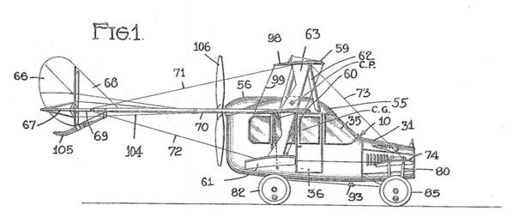

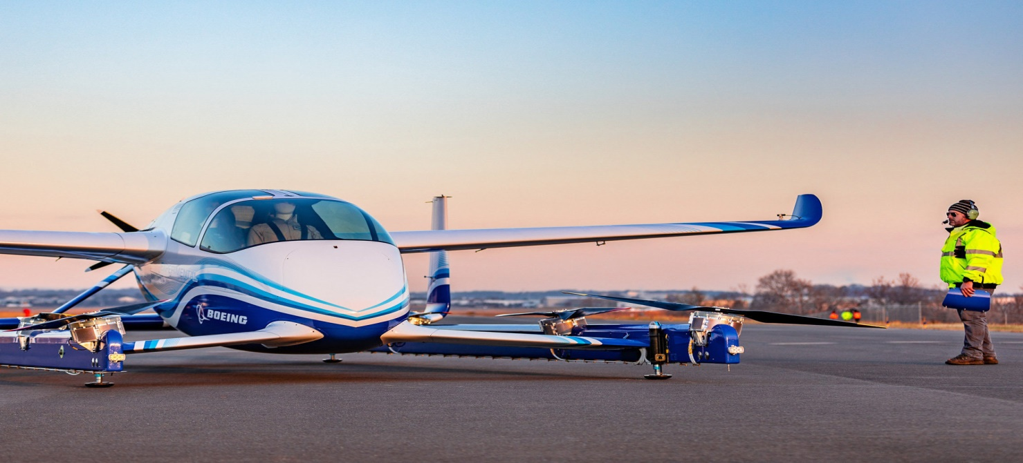
Flying Taxi
a flying vehicle with a range of 50 to 120 miles, carrying one to four passengers, and cruising at an altitude of 3,000 to 5,000 feet.
Introduction

Slide 3
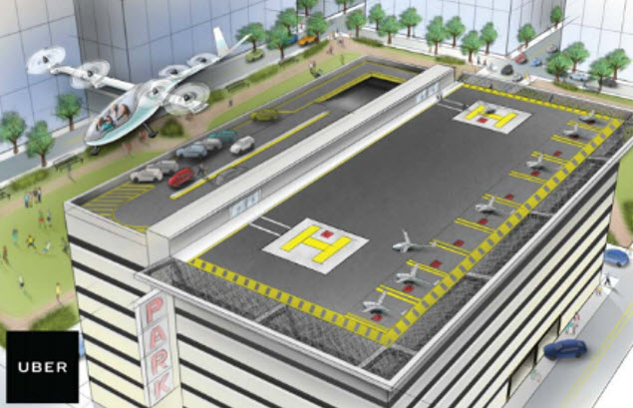
Why attractive idea
Traffic jam problem
Infrastructure cost
Reduce emission and improve safety
Obstacles we need to pass
Introduction
Energy limitations
The public is ready to fly aboard an air taxi with no pilot
Our current air traffic control systems doesn’t accommodate air taxies

Slide 4

Flying taxi categories
Passenger drone:
Electric or hybrid electric
Move people or cargo
Manually piloted, remotely piloted or fully autonomous
Cover short to medium range up to 65 miles
will take flight by 2020
Introduction

Slide 5
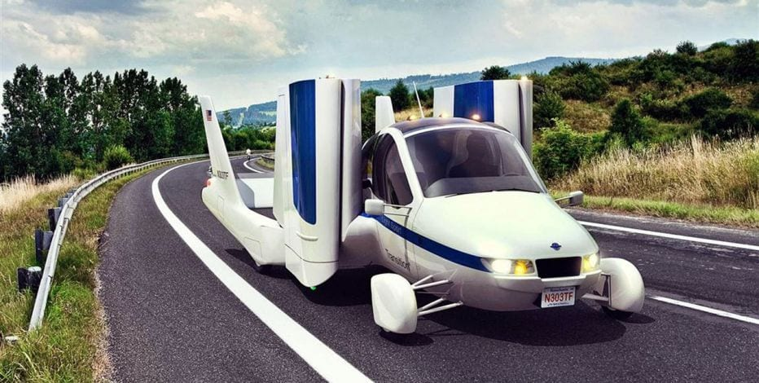
Flying taxi categories
Traditional flying cars:
Can be driven in car configuration to the airport then change it to airplane mode
Need licensed pilot
Cover medium to long range
will take flight by 2020-2022
Introduction

Slide 6
Flying taxi categories
revolutionary vehicles:
combine a passenger drone and traditional flying car
Fully autonomous vehicle
Cover long range (greater than 200 miles)
Have advanced VTOL capability
It could take until 2025 before they become a reality
Introduction

Slide 7
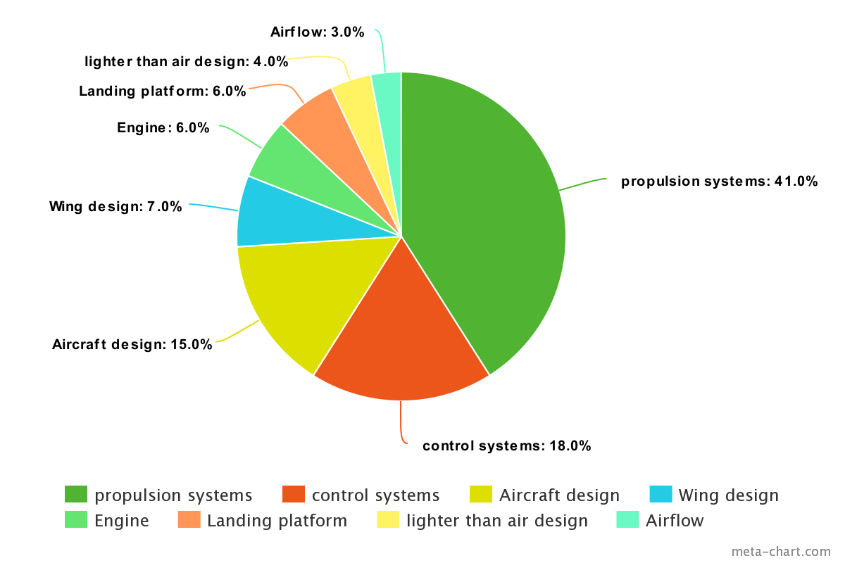
Technology areas dominating air taxi technology
Introduction

Slide 8






The key players in the flying car space
Introduction

Slide 9

The key players in the flying car space
Boeing flying taxi:
Has completed the first test of its autonomous electric VTOL
Introduction

Slide 10
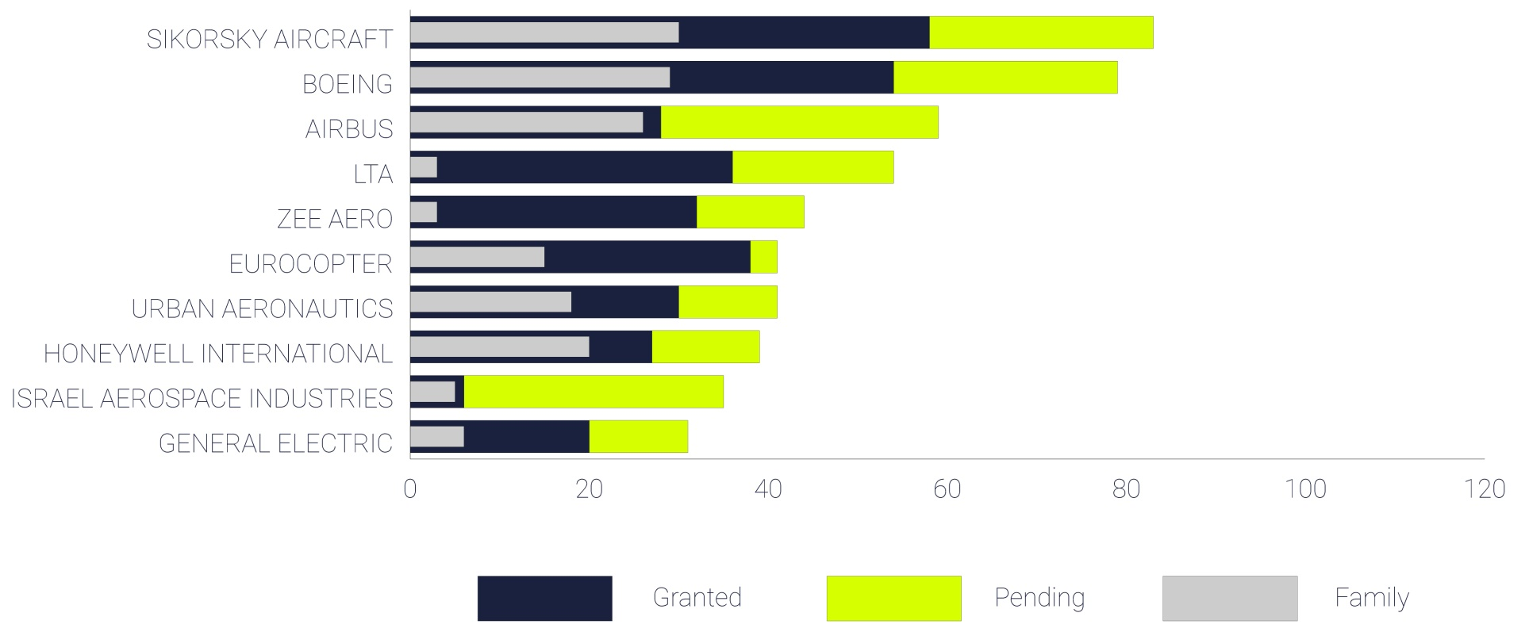
The key players in the flying car space
Patent portfolio:
Introduction

Slide 11
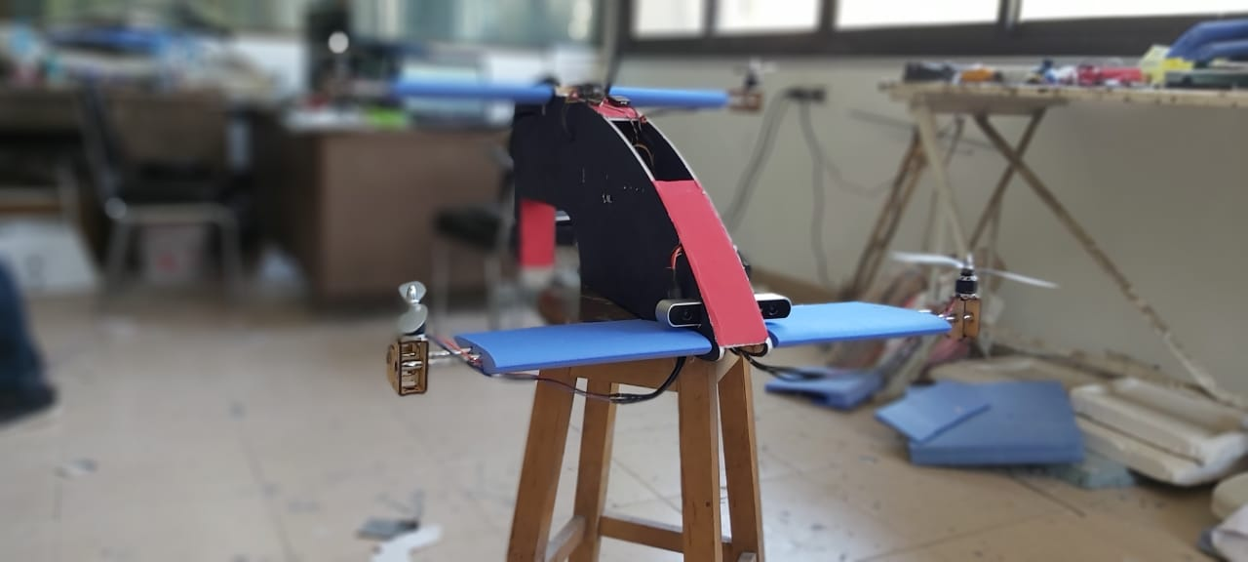
Our prototype
Introduction

Slide 12

Vehicle design
Before designing the vehicle, goals, mission and constraints must be defined well to achieve the highest performance and efficiency:
Mission
Flying taxi which takeoff and landing at streets of the city
Constraints
Max. takeoff weight about 3 Kg.
Max. wide of vehicle 0.8 meter.
Minimum length for easy landing at any place.
AC Design

Slide 13
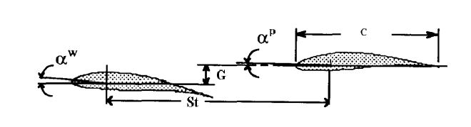

Wing configuration
Design parameters of Tandem wing plane
AC Design
Stagger ($St$)
Gap ($G$)
Decalage ($δ=α^{ω}−α^{p}$)

Slide 14
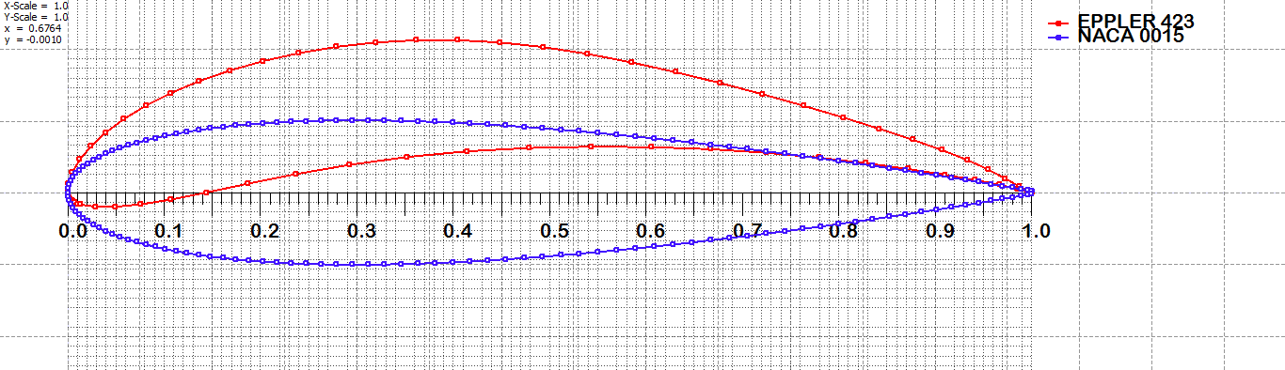
Design Criterion
Airfoil selection
AC Design
Eppler423 (higher lift)
NACA0015 (easy to manufacture)

Slide 15
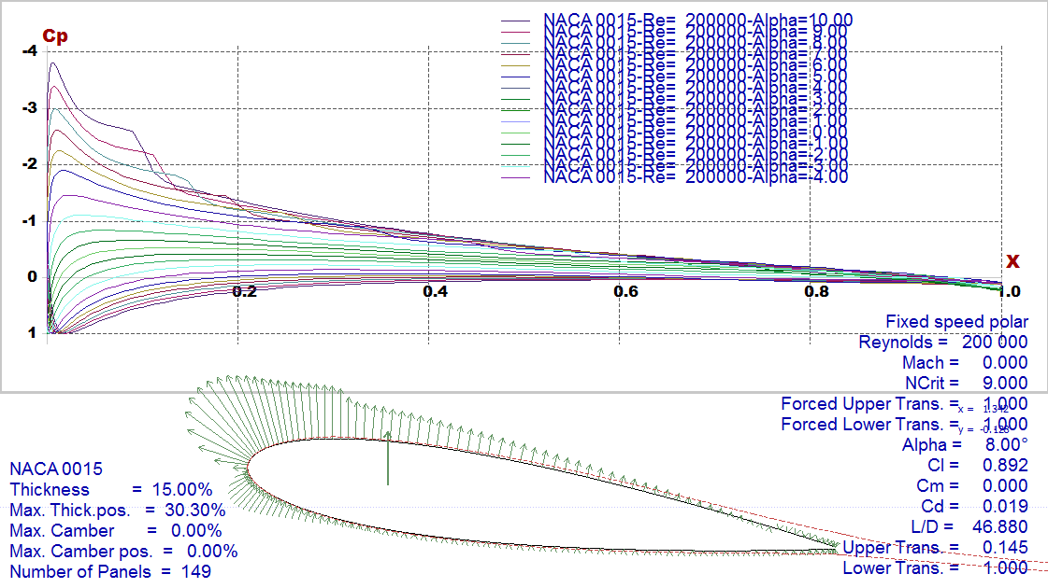
Analyzed airfoils
NACA0015
AC Design

Slide 16
Analyzed airfoils
NACA0015
AC Design

Slide 17
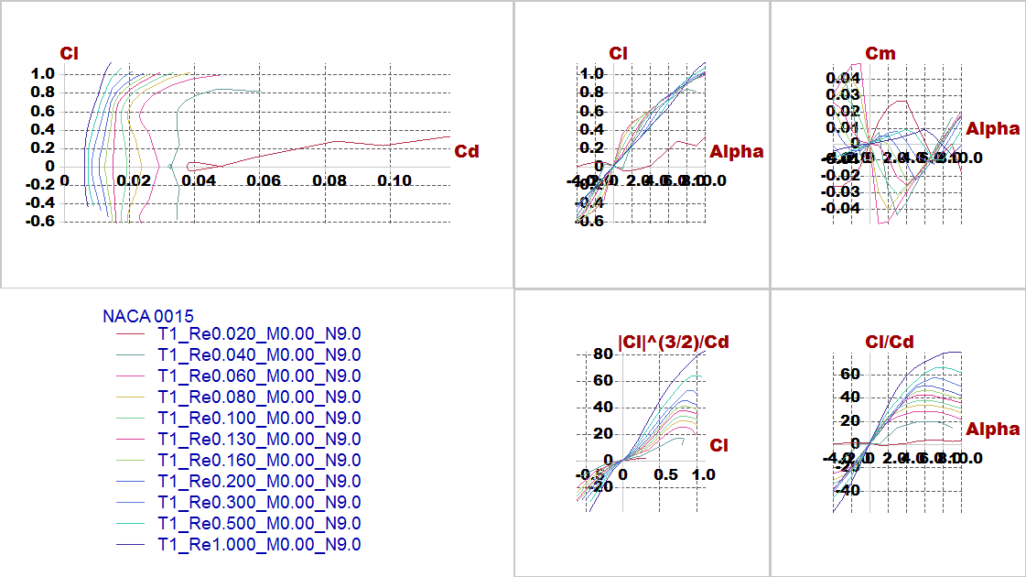
Analyzed airfoils
NACA0015
AC Design

Slide 18
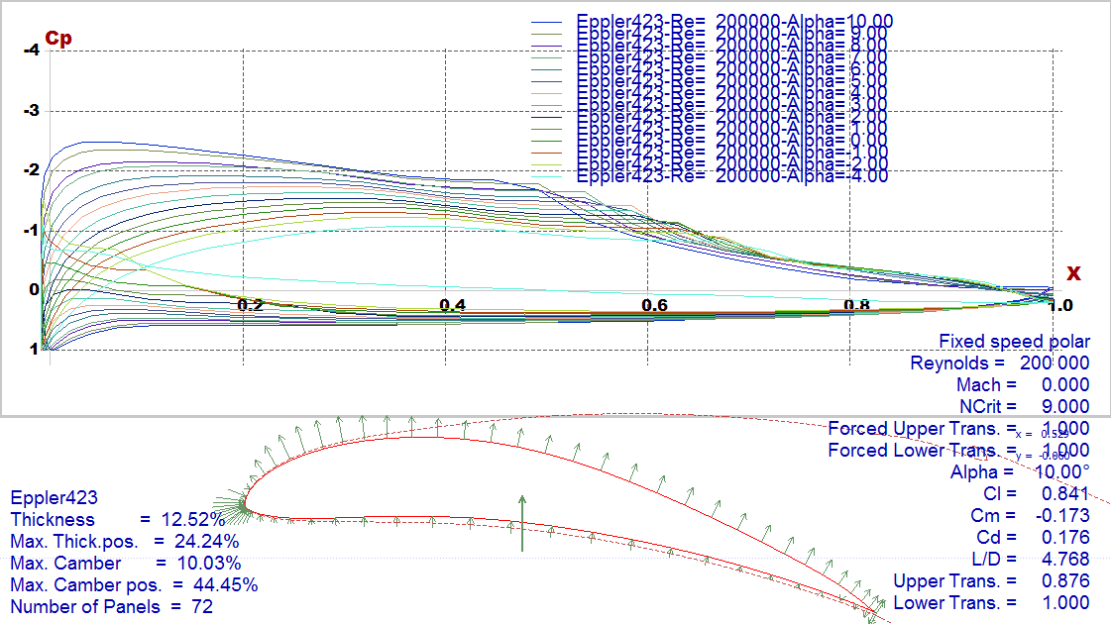
Analyzed airfoils
Eppler423
AC Design

Slide 19
Analyzed airfoils
Eppler423
AC Design

Slide 20
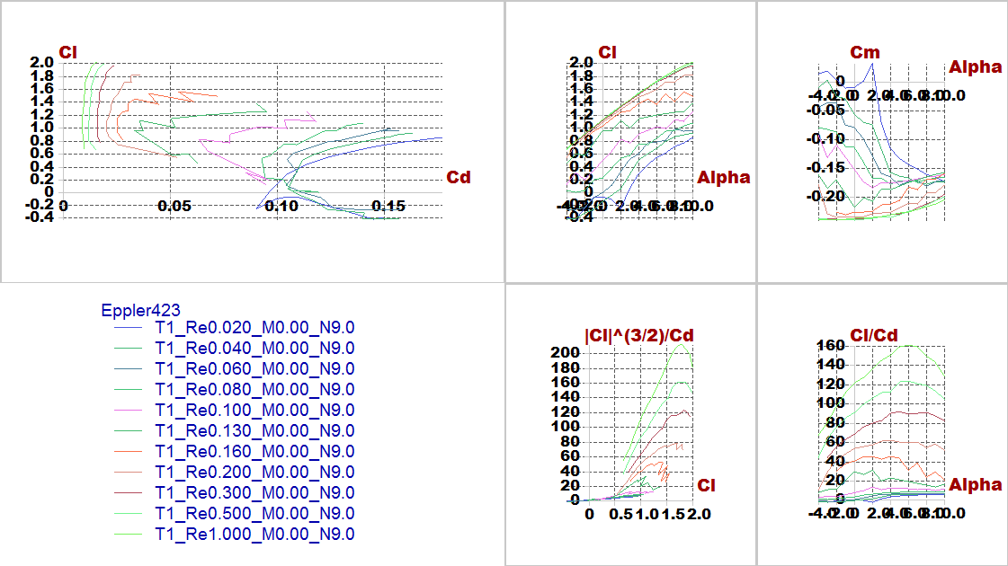
Analyzed airfoils
Eppler423
AC Design

Slide 21
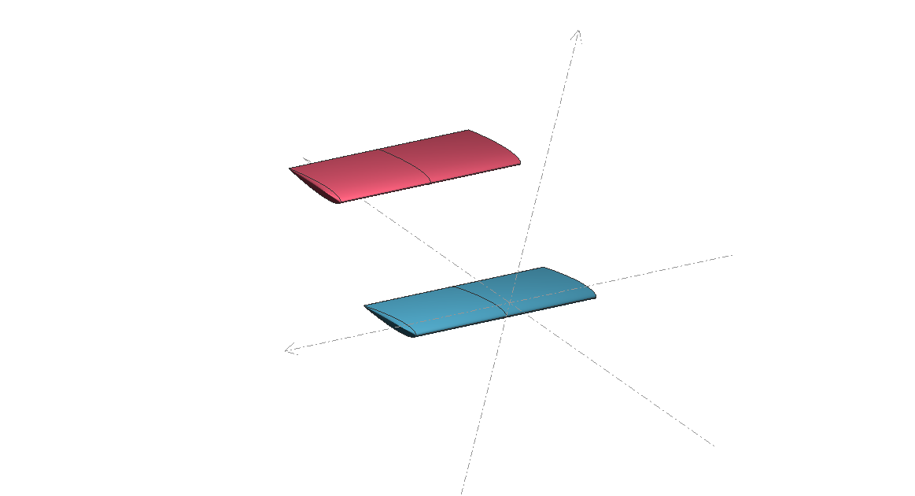
Aerodynamic analysis
After trying different trials considering constraints and requirements, the best configuration has been chosen then stability and lift produced is checked.
AC Design

Slide 22
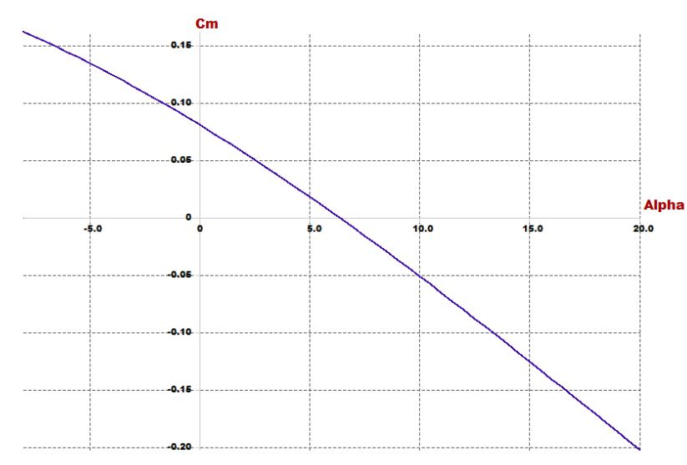
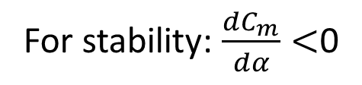
Investigating goals and requirements
For stability: $\frac{dC_{m}}{dα}<$0
AC Design

Slide 23
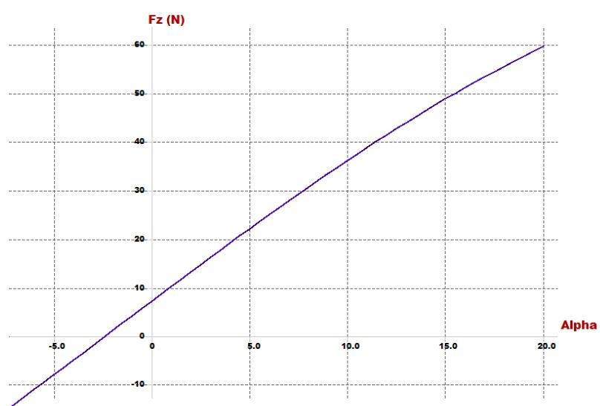
Investigating goals and requirements
For lift: At trim angle the lift must carry the vehicle
AC Design

Slide 24
Design parameters
In this part stability of quad-plane is checked and the airfoil design parameters (incidence angle, CG position, cruise speed and dimensions of wings) is chosen
Parameter | Effect on the vehicle
Span | proportional with lift
Chord | proportional with lift
Cruise speed | proportional with lift
Arm | Static stability
Incidence angle | Static stability
Position of CG | Static stability
Position of second wing | Static stability
AC Design

Slide 25
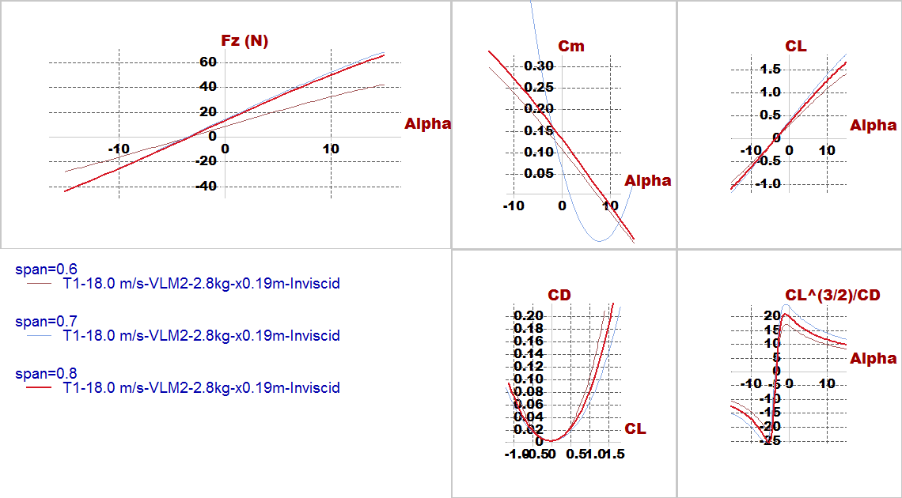
Effect design parameters
Span
AC Design

Slide 26
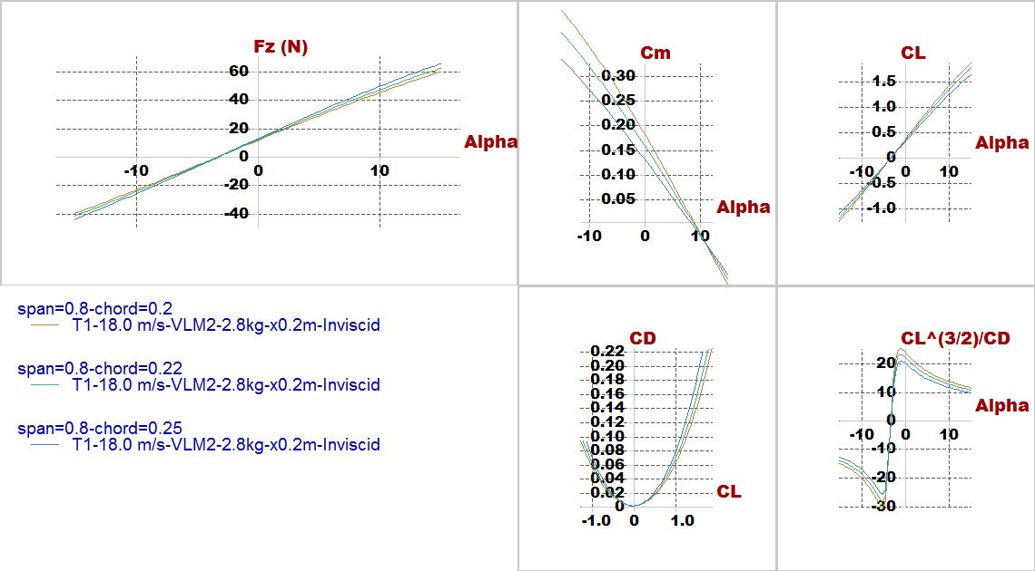
Effect design parameters
Chord
AC Design

Slide 27
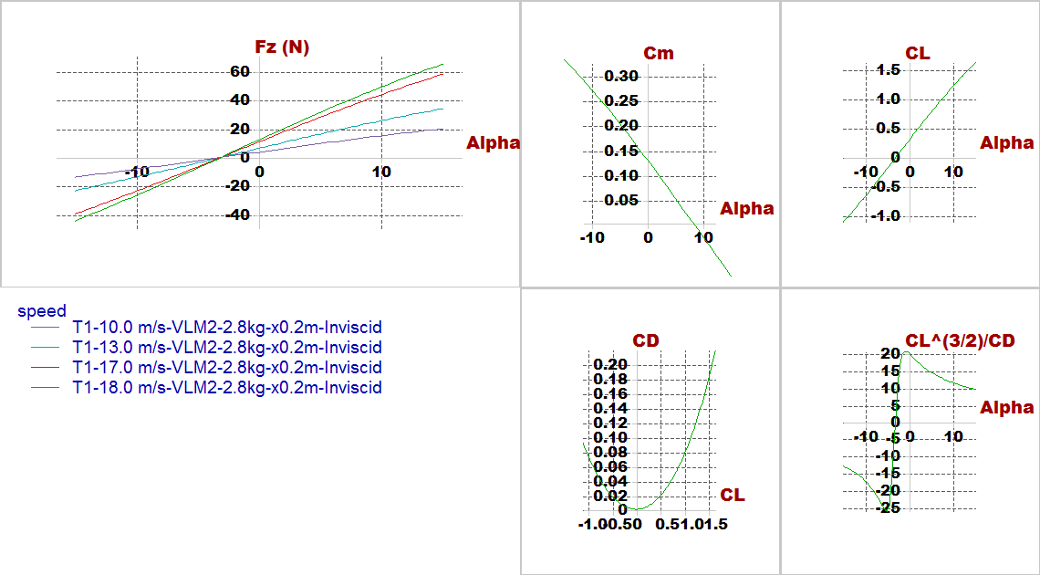
Effect design parameters
Cruise speed
AC Design

Slide 28
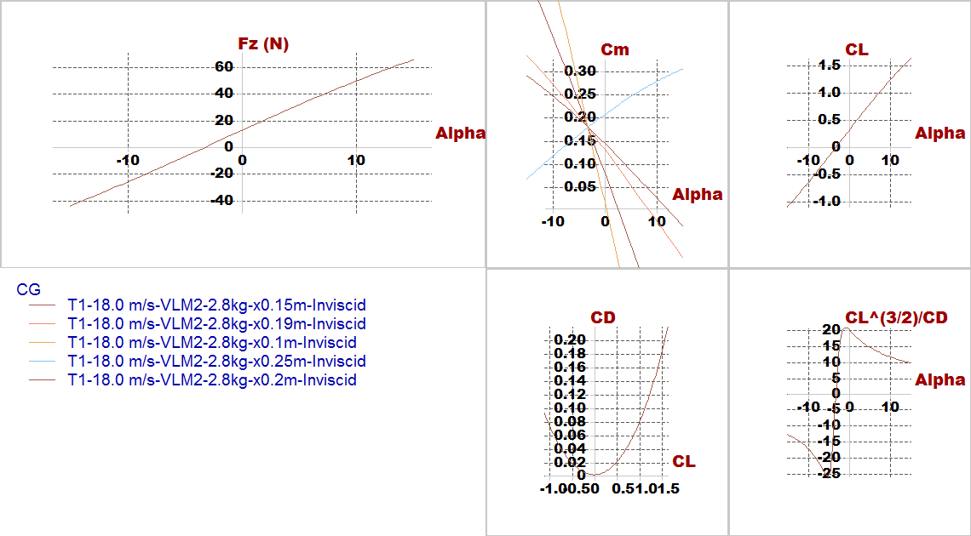
Effect design parameters
C.G.
AC Design

Slide 29
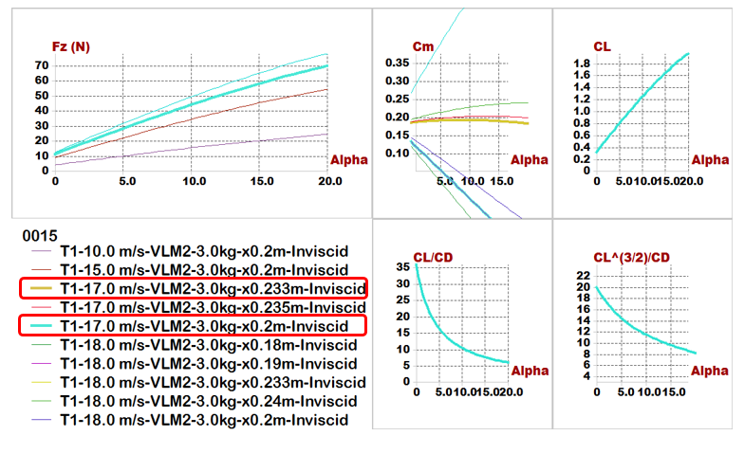
Results
Plane analysis(NACA0015)
AC Design

Slide 30
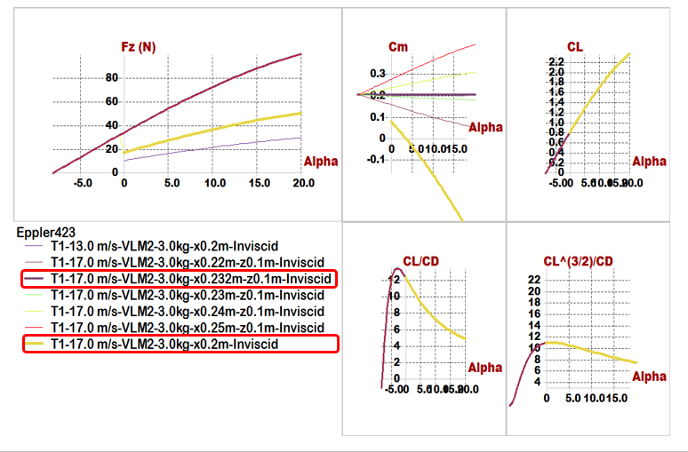
Results
Plane analysis(Eppler423)
AC Design

Slide 31
Quick comparison between 2 airfoils
Comparisons \ Models | Model 1 (NACA0015) | Model 2 (Eppler423)
Position of Main wing | x= 0, z= -0.05 m | x= 0, z= -0.05 m
Position of Second wing | x= 0.45 m, z= 0.1 m | x= 0.45 m, z= 0.15 m
Span | 0.8 m | 0.6 m
Chord | 0.25 m | 0.2 m
Aspect ratio | 3.2 | 3
Cruise speed | 17 m/s | 17 m/s
Incidence of Main wing | 5 degree | 3 degree
Incidence of Second wing | 2 degree | -8 degree
Trim angle | 5.1 degree | 3.6 degree
𝑿_𝑪.𝑮 | 0.19 m | 0.2 m
𝑿_𝑵.𝑷 | 0.233 m | 0.25 m
Degree of Static Stability (S.M.) | 17.2% | 25%
AC Design

Slide 32
Optimization for aerodynamic stability
In this phase trying to put point of C.G. in the middle of the vehicle to equalize the value of moments resulting from two wings to optimize the (𝐶𝑚−𝛼) graph, PX4 requirements, easy to manufacturing and high accuracy results during assembly.
Parameter | Effect on the vehicle
Span | proportional with lift
Chord | proportional with lift
Cruise speed | proportional with lift
Arm | Static stability
Incidence angle | Static stability
Position of second wing | Static stability
AC Design

Slide 33
Optimization for aerodynamic stability
Comparisons \ Models | Model (NACA0015)
Position of Main wing | x= 0 , z=0
Position of Second wing | x= 0.6 m , z= 0.3 m
Span of main wing | 0.6 m
Span of second wing | 0.75 m
Chord of main wing | 0.2 m
Chord of second wing | 0.22 m
Aspect ratio | 3.2
Cruise speed | 18 m/s
Incidence of Main wing | 9 degree
Incidence of Second wing | 8 degree
Trim angle | 0.3 degree
𝑿_𝑪.𝑮 | 0.36 m
Z_𝑪.𝑮 | 0.15 m
𝑿_𝑵.𝑷 | 0.381 m
Degree of Static Stability (S.M.) | 10.5%
Reylonds number | About (100,000 to 200,000)
AC Design

Slide 34
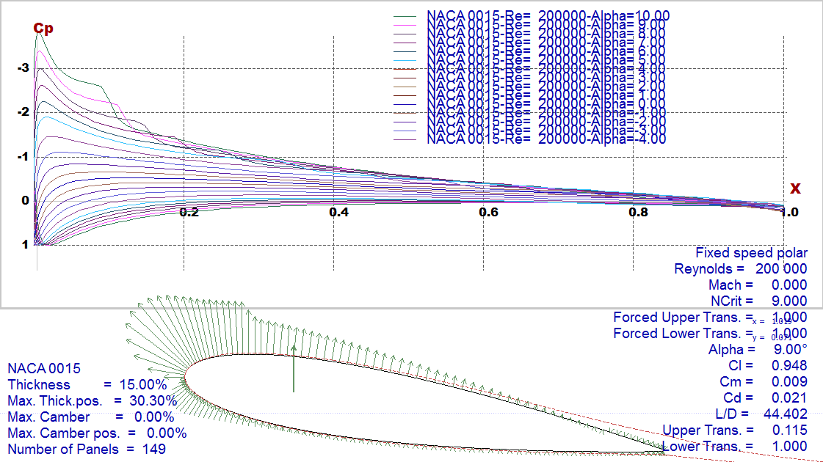
Final Results
Foil characteristics
AC Design

Slide 35
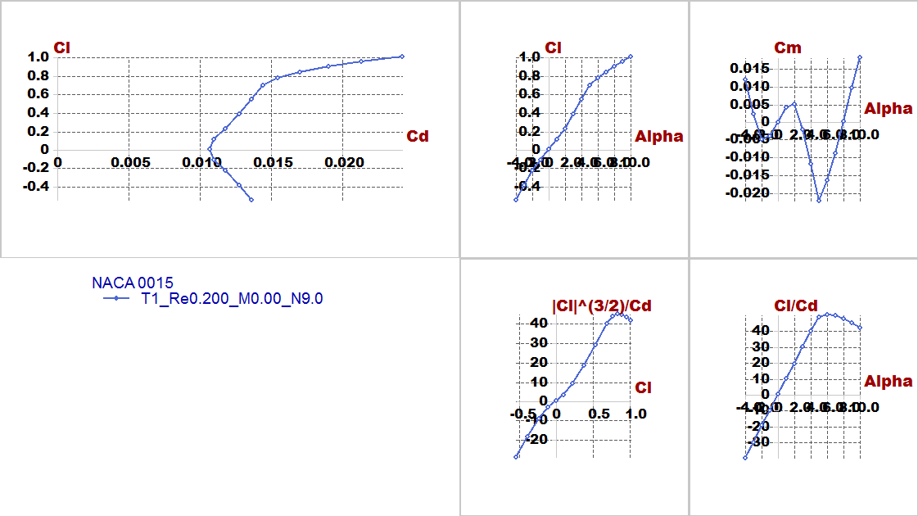
Final Results
Foil characteristics
AC Design

Slide 36
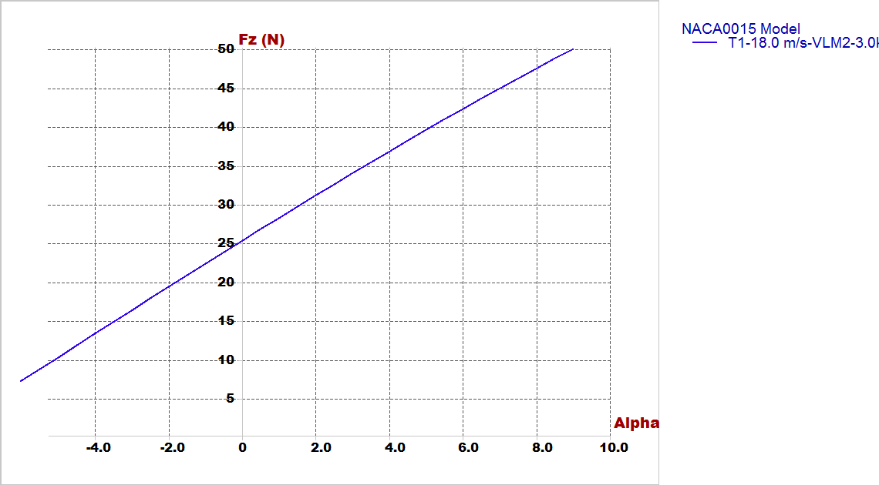
Final Results
2. Lift Vs alpha
AC Design

Slide 37
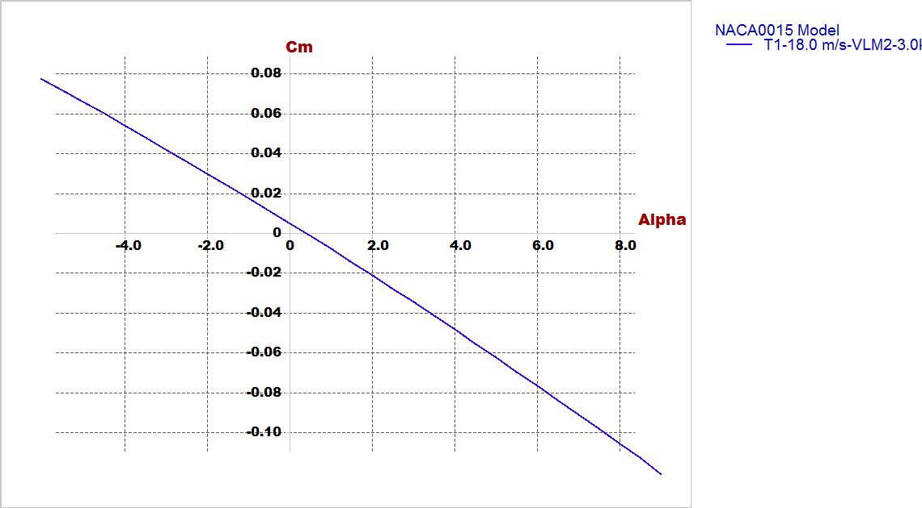
Final Results
3. Cm Vs alpha
AC Design

Slide 38
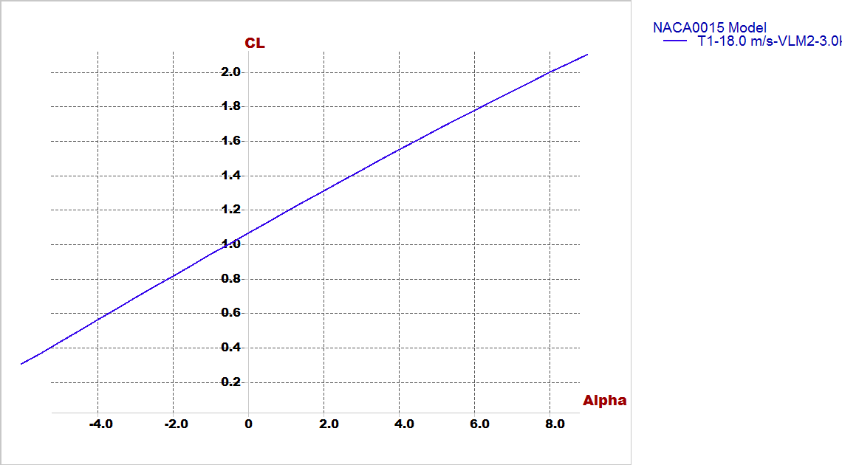
Final Results
4. Cl Vs alpha
AC Design

Slide 39
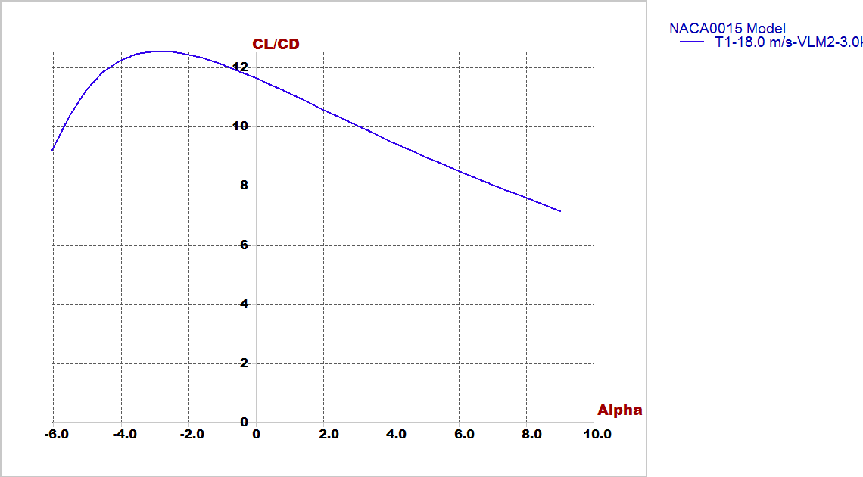
Final Results
5. Cl/Cd Vs alpha
AC Design

Slide 40
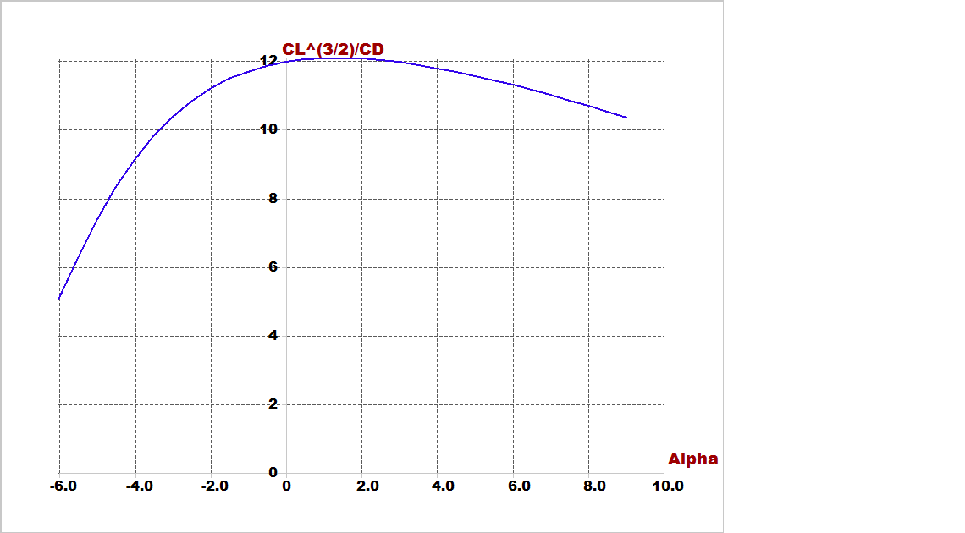
Final Results
6. Cl^(3/2)/Cd Vs alpha
AC Design

Slide 41
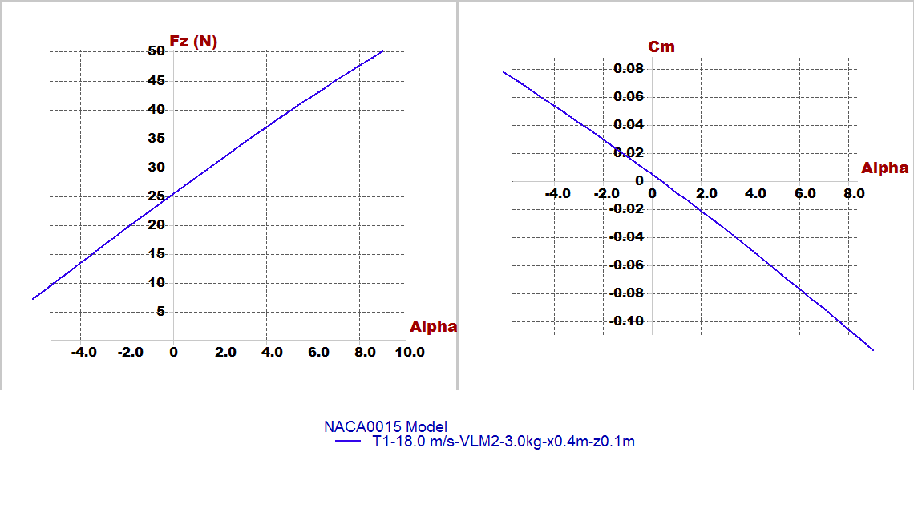
Stability Analysis
In experimental design checking for results very important by focus on 2 important figures:(longitudinal static stability and lift generated from airfoil)
AC Design

Slide 42
Stability Analysis
We will illustrate this part by video its shown modes of longitudinal and lateral stability of plane by root locus and time response.
B. For lateral:
Type1: roll damping.
Type2,3: Dutch roll mode.
Type4: spiral mode.
For longitudinal:
Type1: short period mode.
Type2: Pitching.
Type3,4: motion around steady state flight.
AC Design

Slide 43
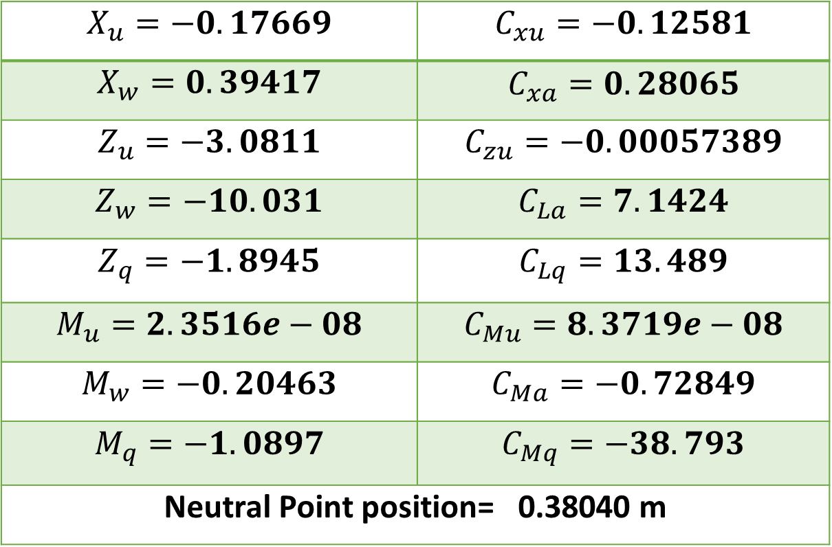
Stability Analysis
Longitudinal derivatives from Xflr5:
$$X_{u}=−0.17669$$ | $$C_{xu}=−0.12581$$
$$X_{w}=0.39417$$ | $$C_{xa}=0.28065$$
$$Z_{u}=−3.0811$$ | $$C_{zu}=−0.00057389$$
$$Z_{w}=−10.031$$ | $$C_{La}=7.1424$$
$$Z_{q}=−1.8945$$ | $$C_{Lq}=13.489$$
$$M_{u}=2.3516e−08$$ | $$C_{Mu}=8.3719e−08$$
$$M_{w}=−0.20463$$ | $$C_{Ma}=−0.72849$$
$$M_{q}=−1.0897$$ | $$C_{Mq}=−38.793$$
Neutral Point position= 0.38040 m
AC Design

Slide 44
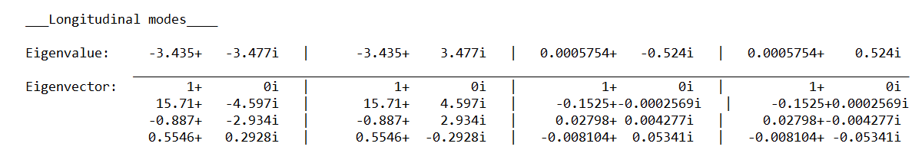
Stability Analysis
Root locus for longitudinal:
AC Design

Slide 45
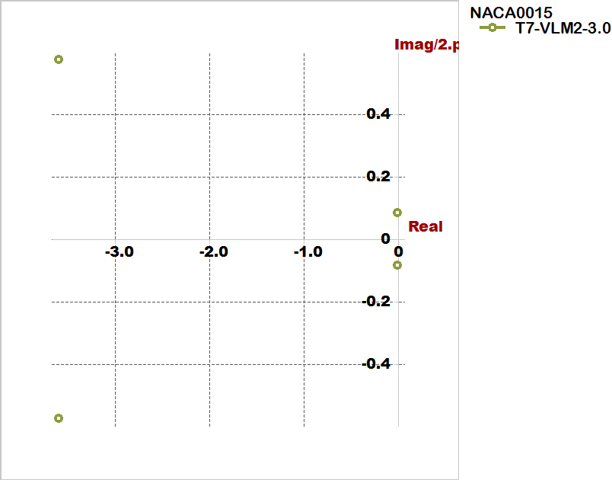
Stability Analysis
Root locus for longitudinal:
AC Design

Slide 46
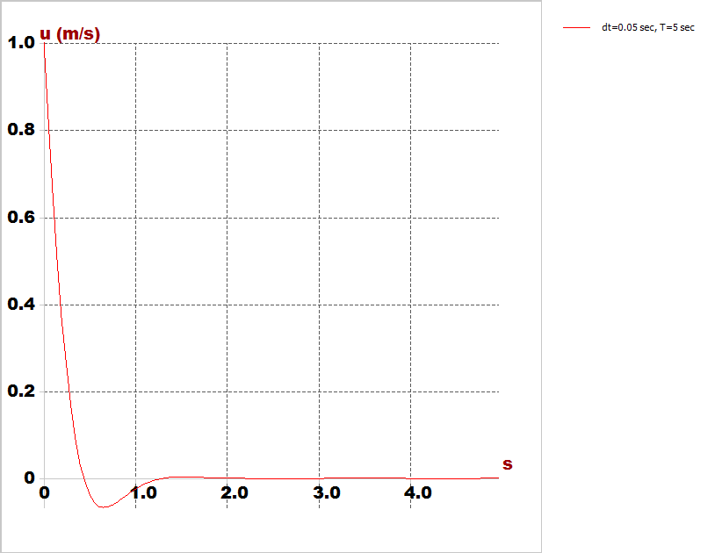
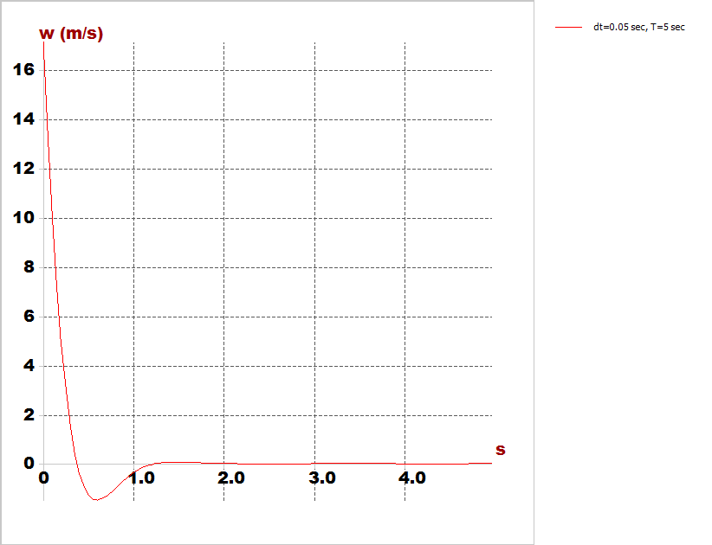
Stability Analysis
Time response characteristics:
Longitudinal response modes
Horizontal speed response
Vertical speed response
AC Design

Slide 47
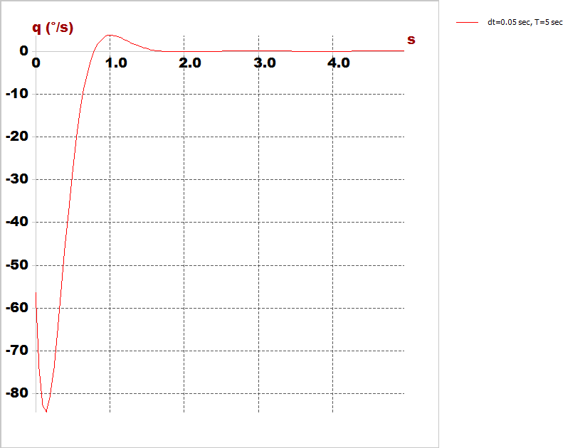
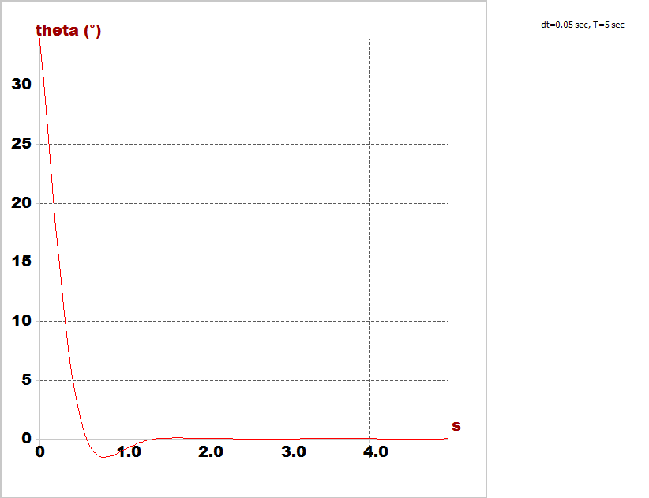
Stability Analysis
Time response characteristics:
Longitudinal response modes
Pitch rate
Pitch angle
AC Design

Slide 48
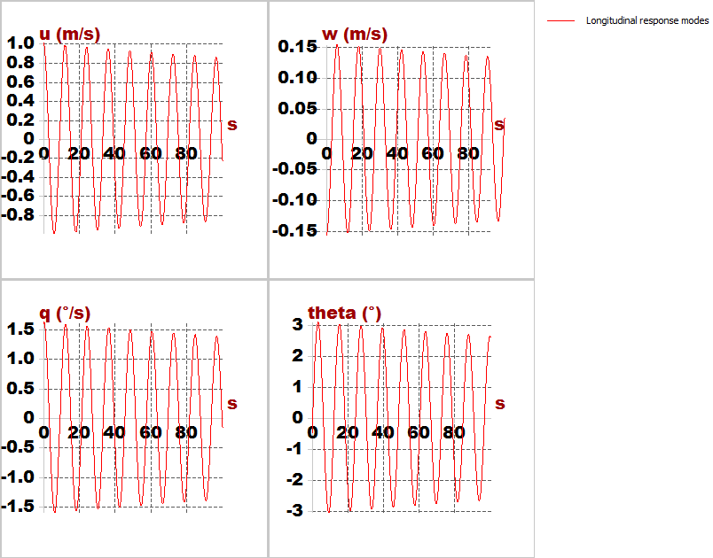
Stability Analysis
Longitudinal response modes
AC Design

Slide 49
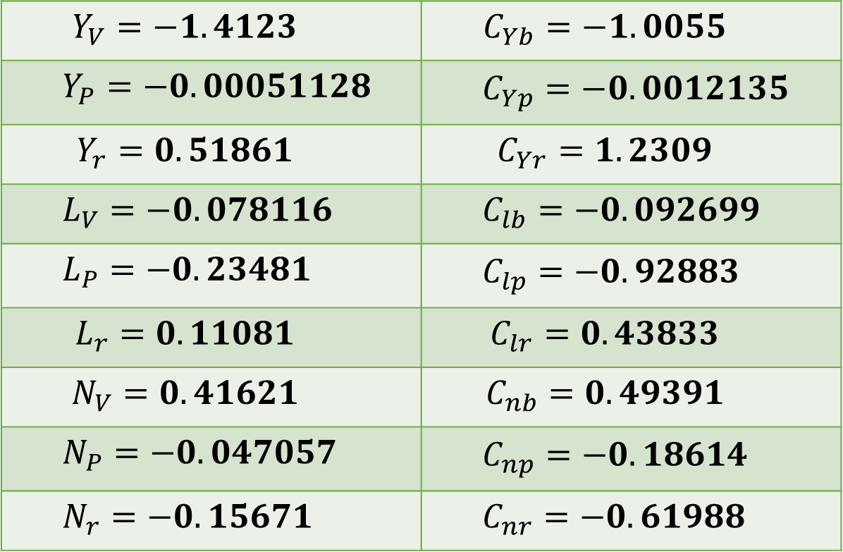
Stability Analysis
Lateral derivatives from Xflr5
$$Y_{V}=−1.4123$$ | $$C_{Yb}=−1.0055$$
$$Y_{P}=−0.00051128$$ | $$C_{Yp}=−0.0012135$$
$$Y_{r}=0.51861$$ | $$C_{Yr}=1.2309$$
$$L_{V}=−0.078116$$ | $$C_{lb}=−0.092699$$
$$L_{P}=−0.23481$$ | $$C_{lp}=−0.92883$$
$$L_{r}=0.11081$$ | $$C_{lr}=0.43833$$
$$N_{V}=0.41621$$ | $$C_{nb}=0.49391$$
$$N_{P}=−0.047057$$ | $$C_{np}=−0.18614$$
$$N_{r}=−0.15671$$ | $$C_{nr}=−0.61988$$
AC Design

Slide 50
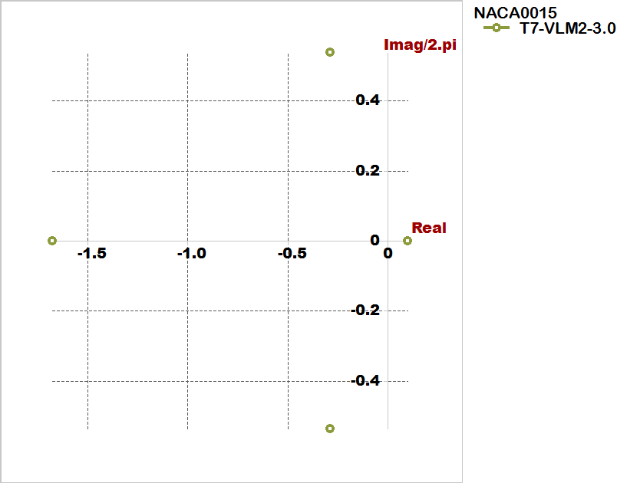
Stability Analysis
Root locus for lateral:
AC Design

Slide 51
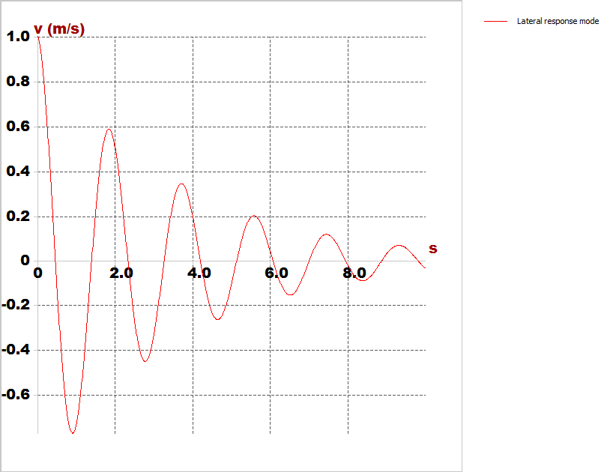
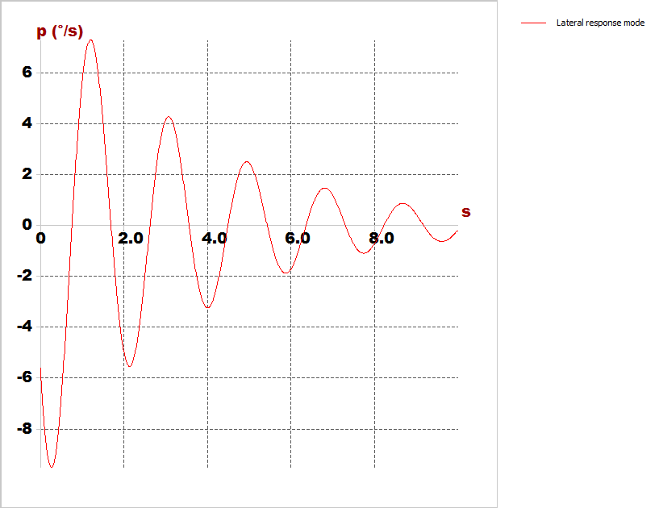
Stability Analysis
Time response characteristics:
Lateral response modes
Cruise speed
Roll rate
AC Design

Slide 52
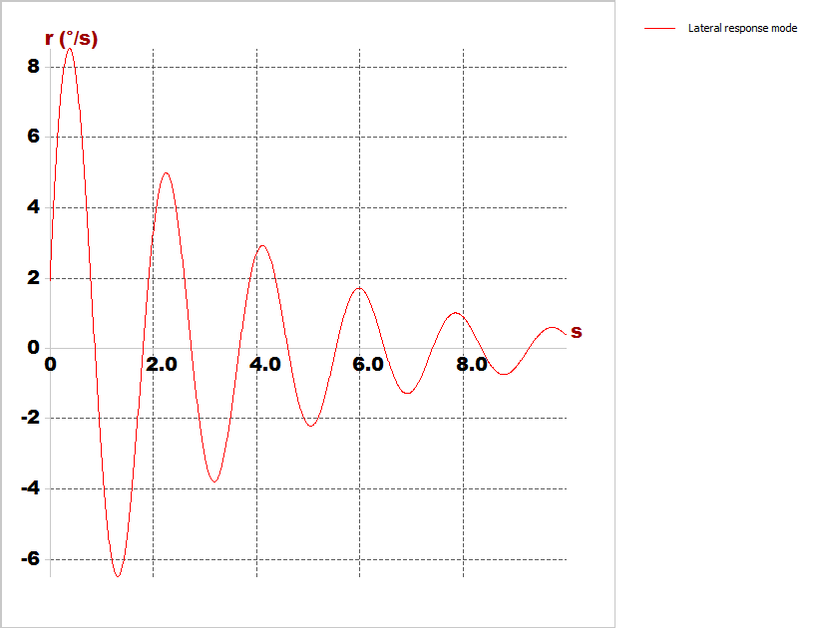
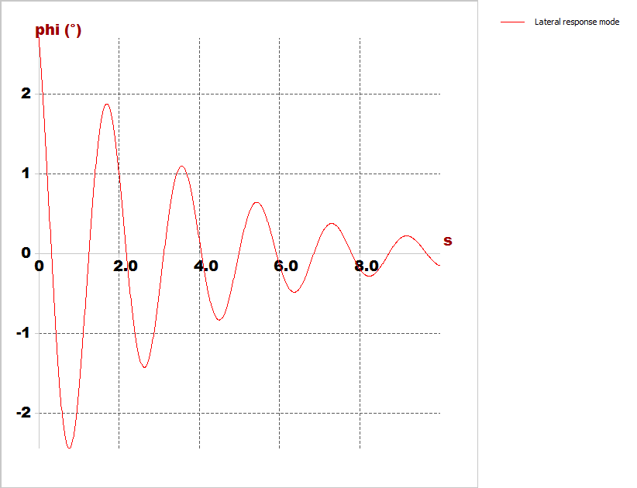
Stability Analysis
Time response characteristics:
Lateral response modes
Yaw rate
Bank angle
AC Design

Slide 53
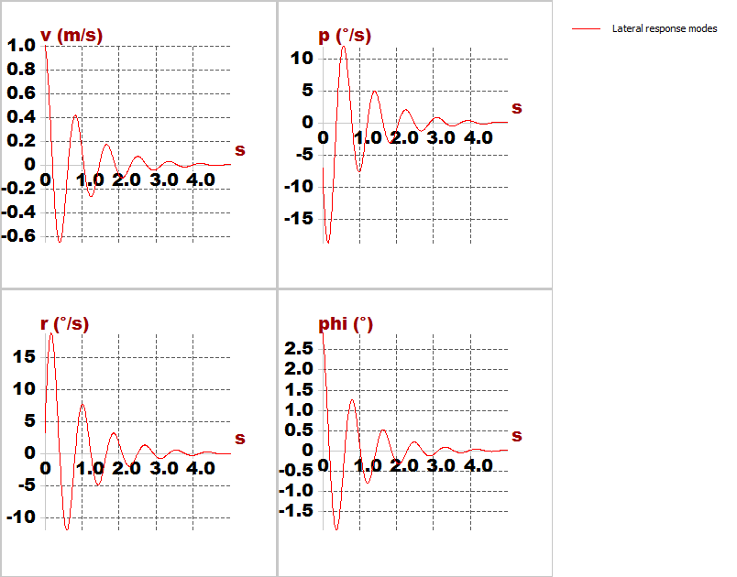
Stability Analysis
Lateral response modes
AC Design

Slide 54
AC Design

Slide 55
AC Design

Slide 56

Autopilot

Slide 57

Computer Vision

Slide 58

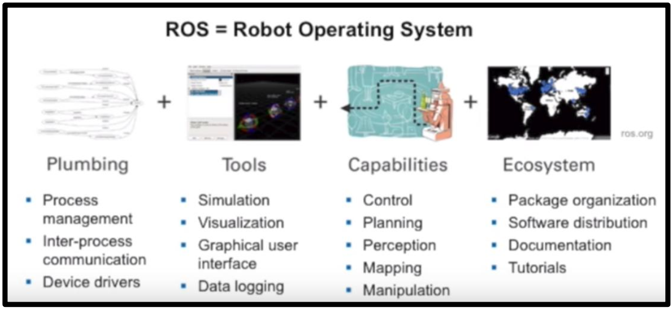

Implementation
Why ROS ?
Implementation

Slide 59
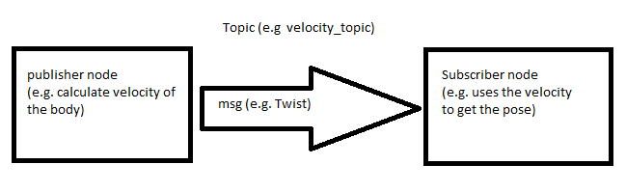
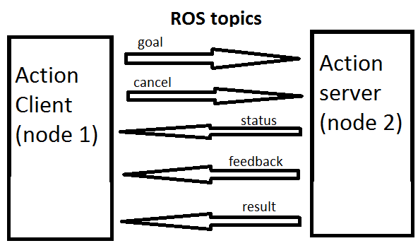
some important features in ROS
ROS master
ROS nodes
ROS topics
ROS messages
ROS packages
ROS services
ROS actions
Implementation

Slide 60
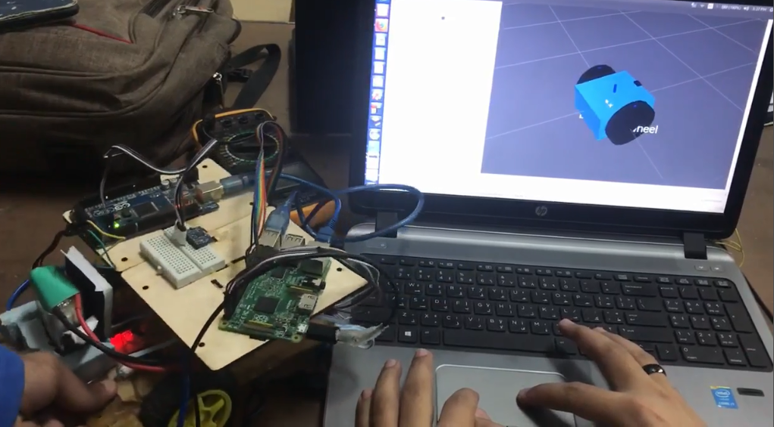
increase our experience in ROS and Its features
Deferential Drive Robot (DD robot)
Implementation

Slide 61

Modeling
Objective
Control the DD robot linear velocity and angular velocity
Localize the DD robot by fusing the data from IMU and odometry from encoders
Implementation

Slide 62

Block Diagram
Implementation

Slide 63

1D Bi-rotor
validate ROS performance in aerospace applications
Block Diagram
Conjuration 1 (ROS PID) (Low-pass filter on derivative term)
Implementation

Slide 64

Controller Tuning in Real time
Implementation

Slide 65

Configuration 2 (PIDA)
Implementation

Slide 66

Results & Conclusions
Sampling Time
Comparison between configuration 1 and Configuration 2 sampling time
Implementation

Slide 67



Effect of not constant Sampling time
Put $K_{d}$=$K_{I}$=$K_{a}$=0 , $K_{p}$=value ,Hence Controller=$K_{p}=error=−K_{p}∗state$
Implementation
$$T_{s}=\text{Constant}$$

Slide 68


$$T_{s}≠\text{Constant}$$

Slide 69


Gains tuning (Comparing between ROS and my PID controller)
Implementation
(a) $K_{p}=60 , K_{I}=10 , K_{D}=30$, cutto-freq (Low pass lter on derivative term) = 40 Hz

Slide 70


Gains tuning (Comparing between ROS and my PID controller)
Implementation
(b) ${ROS pid K}_{p}=60 , K_{I}=15 , K_{D}=30$, cutto-freq (Low pass lter on derivative term) = 40 Hz ,and same gains for my PID but adding $K_{a}=10$ (to resist error acceleration)

Slide 71

Comparing between ROS and my PID controller on one graph
Implementation

Slide 72

Comparing between ROS and my PID controller on one graph
Implementation

Slide 73

PX4 autopilot(PX4 , ROS and Gazebo)
Implementation

Slide 74

MAVROS and MAVLink messages interpretation
Implementation

Slide 75
VIDEO Position control
Position Control Using(PX4,Gazebo simulation,MAVROS)
Our simulation simple test
Implementation

Slide 76
Implementation

Slide 77


Wiring
The first problem was to connect all the components together and get the vehicle started .
Flight test

Slide 78


Ground Stations
Qgroundcontrol
Mission Planner
Flight test
Open source
Cross platform
Simple to use
Easier for calibration
Open source
Simple to use
Easier for logging flight data

Slide 79


Installing firmware and selecting airframe
Flight test

Slide 80


Radio Calibration (DX8)
Flight test

Slide 81




Sensors calibrations
Compass
Gyroscope
Flight test
Accelerometer
Level horizon

Slide 82

ESCs and Battery calibration
Flight test

Slide 83




Tuning
Hovering thrust
Pitch
Flight test
Roll
Yaw

Slide 84


Flight modes
Manual / stabilized
Flight test
Acrobatic

Slide 85


Flight modes
Altitude
Flight test
Position

